Slide 1
In the name of God

Slide 2
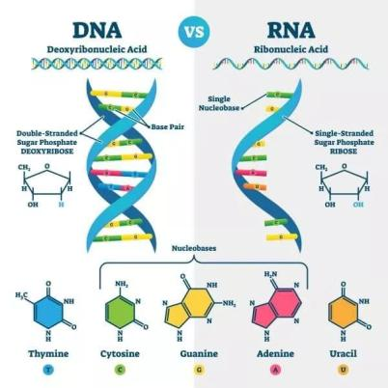
Types of nucleic acids

Slide 3
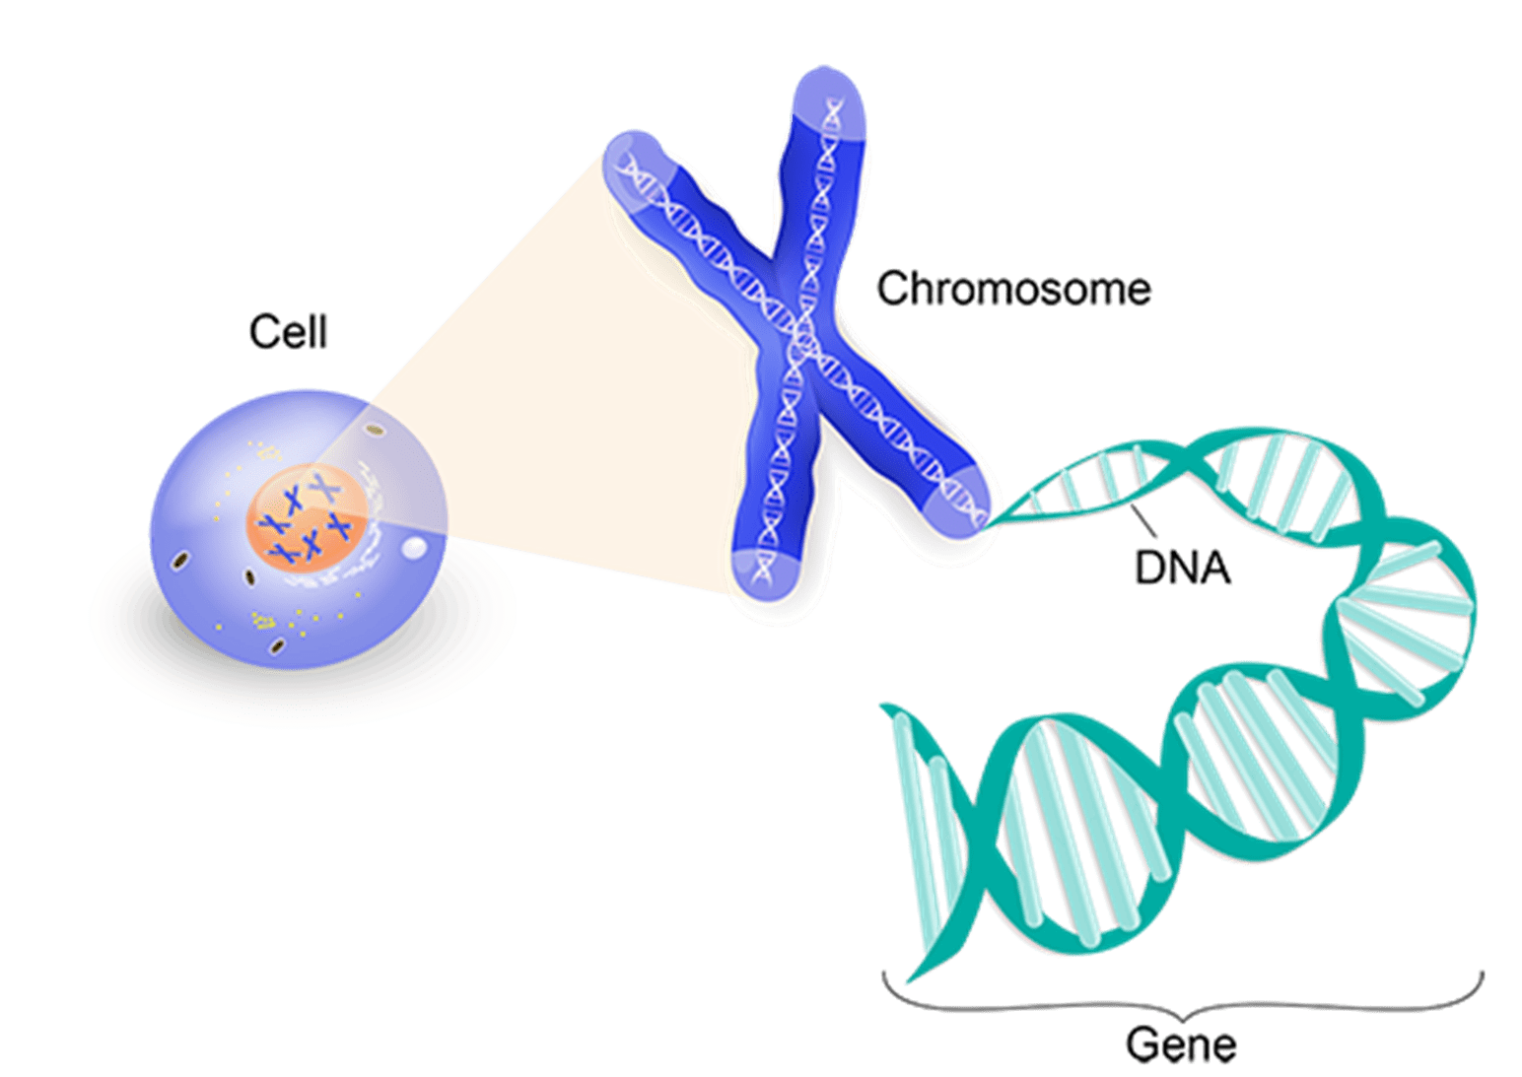
What is Nucleic acids extraction?
Nucleic acids extraction is a process that used to purify DNA or RNA by using chemical or physical methods from a biological sample or separating nucleic acids from protein, cell membranes, and other cellular components.

Slide 4
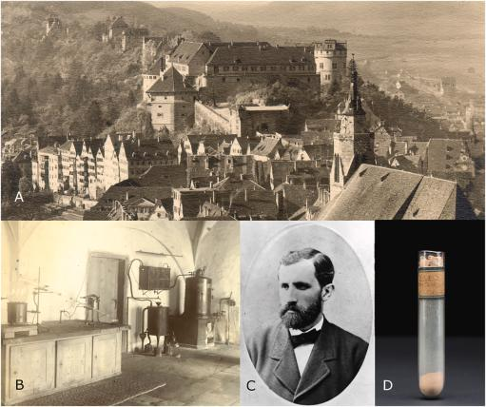
Brief history
Friedrich Miescher (1869)
isolation of the cell material “nuclei” or “nucleic acid” and developing a method for nucleic acid isolation
(RNA and DNA)

Slide 5
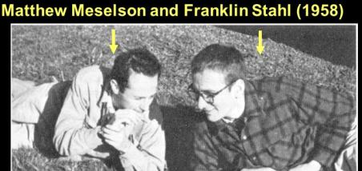
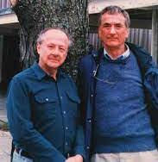
Brief history
Stahl and Meselson (1956)
developing a full-function protocol for DNA extraction (The density gradient centrifugation protocol)
It was the first protocol described for isolating DNA from E.coli bacteria.

